Slide 1
EXPLORATORY DATA ANALYSIS ON TRAVEL INSURANCE
FINAL PROJECT DS102 & DS104 | LEE YI PING

Slide 2
Problem Statement
to understand which risk profile are more likely to have high claim rate of travel insurance
determine the price for the particular plans to be adjusted based on the age, duration and country that is most travelled.

Slide 3
Solution for challenges and difficulties
Data Cleaning
Drop the column of gender
Replacing the age more than 100 years old by the average age of each individual product (https://en.wikipedia.org/wiki/Oldest_people)
Data Quality Assurance
Drop the negative value from duration
replace zero by average duration

Slide 4
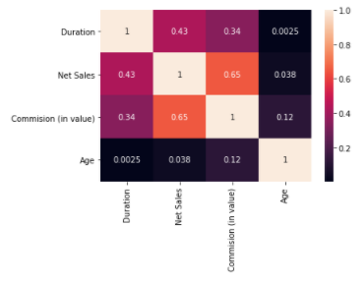
Data findings from top view
Online transaction are more than offline
More IT savvy
An imbalance claim status
Only 1.5%
Correlation of commission and net sales are strong

Slide 5
Data Insights/Visualization/Recommendation
Which product have the most negative net sales transaction and from which agency?
Insights: Negative net sales may be due to some advisers having higher commission rate with the agency.
Recommendations: Agency may adjust the commission paid out based on the commission they received from provider instead of the premium in order to increase the sales.

Slide 6
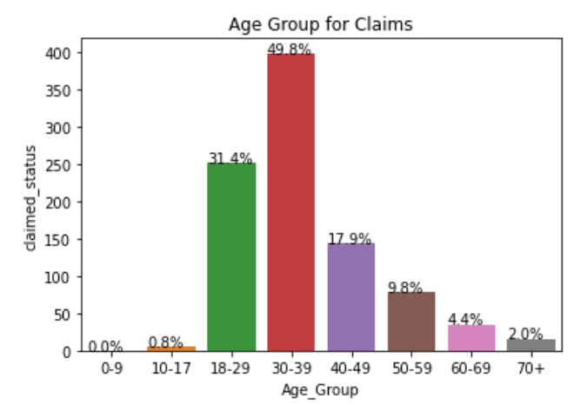
Data Insights/Visualization/Recommendation
Findings of claimed product against age, destination and duration
Insights: Provider may consider to adjust the premium for the highest claimed below:
Age group from 18-49 especially on the age group 30-39 where the claim rate is almost 50% among all other age group.

Slide 7
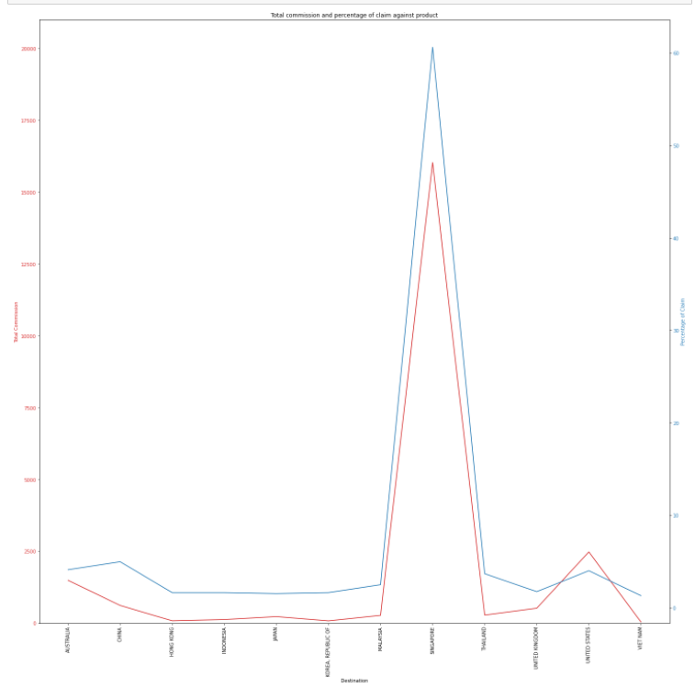
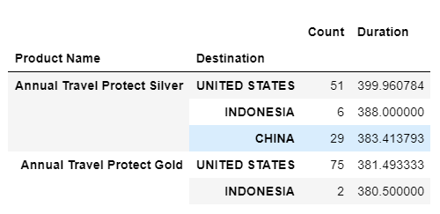
Data Insights/Visualization/Recommendation
Findings of claimed product against age, destination and duration
Singapore have the highest claimed rate which are more than 60% among other countries.
Top 5 average duration from 3 unique countries is more than one year as it is annual coverage.
Recommendations: Shorten the duration of policies and yearly renewal

Slide 8
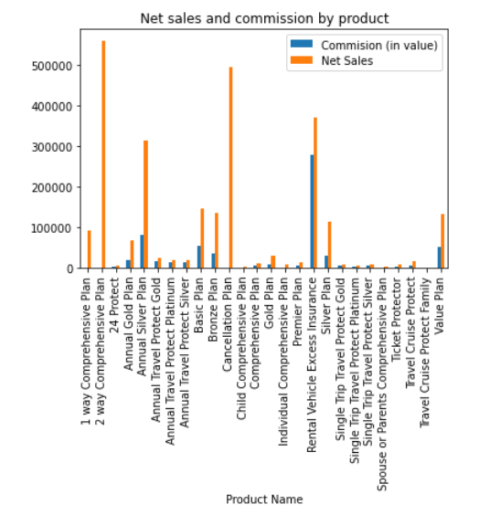
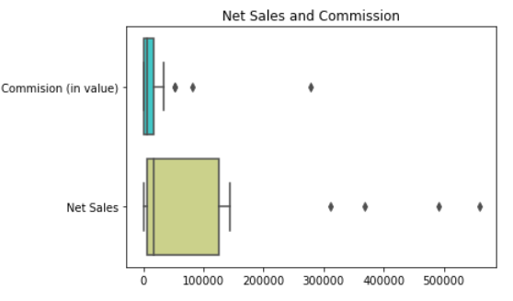
Data Insights/Visualization/Recommendation
Which product have the highest net sales and highest commission?
Top 2 highest sales product without any no commission paid out.
Insights: No mark up on the sales price or the company policy that there will be no commission therefore it is cheaper and worth to purchase
Commission percentage pay out for the product is higher, sales may increase accordingly.

Slide 9
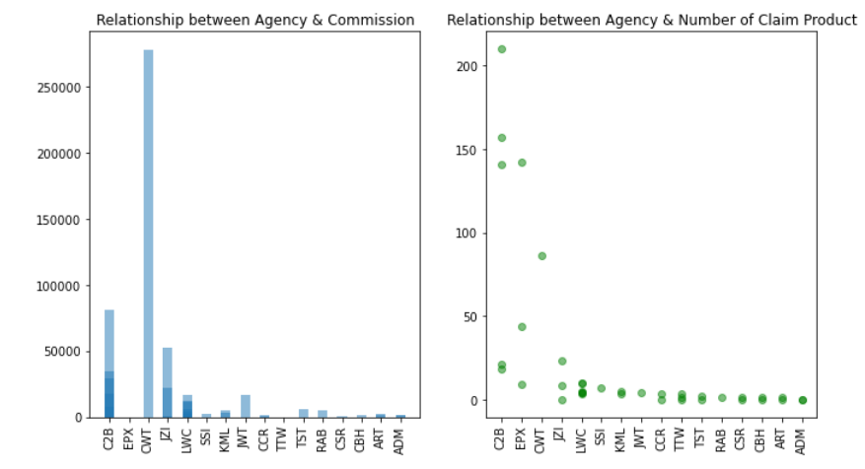
Data Insights/Visualization/Recommendation
Analyze the relationship between age, claim status, commission and claimed product against agency.
CWT has the highest commission and C2B sold the most policies to high risk profiler but it is not the highest claimed product of all agency.
Unique agency companies will not lead to an increase numbers of claimed policies.

Slide 10
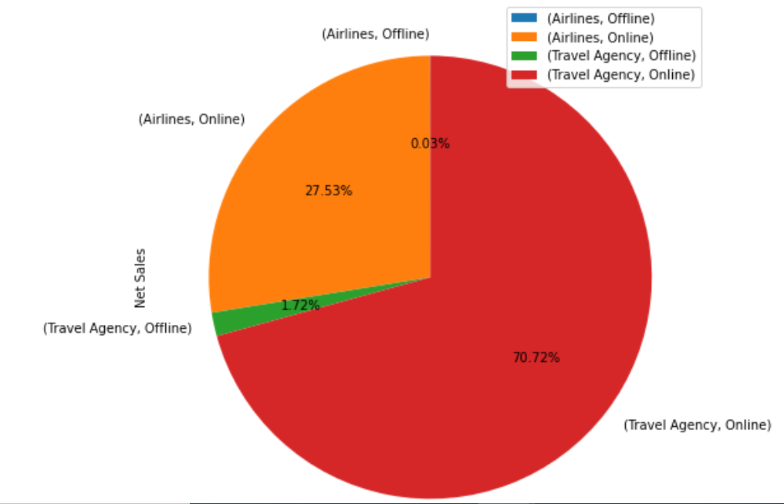
Data Insights/Visualization/Recommendation
What is the percentage of net sales from agency type and distribution channel?
People tend to purchase through travel agency
More options to their needs and it may be in a package with the trips.
More convenient to go through a third party for the purchase of insurance
Client also can have various product from different provider through one channel.

Slide 11
Summary
In general, travel insurance premium is mostly based on destination and duration for the coverage.
Airline agencies should focus more on acquiring customers who opt for airline insurance together with a package while customer purchasing air tickets.
Provider may consider to drop their low performing products which generates lesser revenue
Airline agencies should invest on how to increase their sales via online mode(e-commerce).
Intelligently divide the resources in proportion to the revenue that they generate from different countries.

Slide 12
Appendix
Github Link
https://github.com/aureliapy/final_project/

Slide 13


